Slide 1
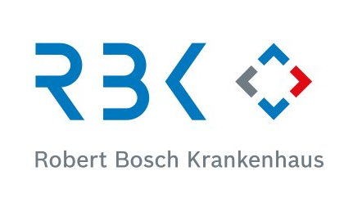
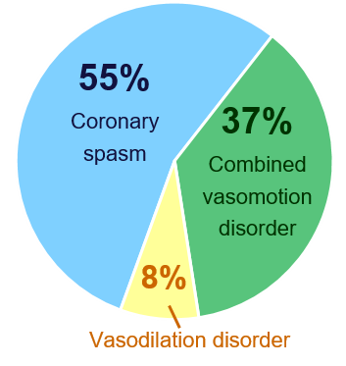
Long-term efficacy of endotype-based drug therapy on quality of life and symptom management in coronary vasomotion disorders
L. Saccardi¹, A. Hubert¹, C. Kroll¹, A. Seitz¹, U. Sechtem¹, R. Bekeredjian¹, P. Ong¹
¹Robert-Bosch-Hospital, Department of Cardiology and Angiology, Stuttgart, Germany
Background
Results
Coronary Vasomotion Disorders are a common cause for Angina pectoris without obstructive coronary artery disease (ANOCA).
They pose a major therapeutic challenge due to:
● heterogeneous clinical presentation
● broad spectrum of subtypes (so-called endotypes) including coronary ----spasm, vasodilation disorders or combined vasomotion disorders
● often long-term refractory symptoms and severely impaired quality of life
Tab 1: Baseline patient characteristics assessed at inclusion (n=50)
Fig 3: SAQ Summary Score (n=38)
↑43.8%
63.0 ± 23.0
p < 0.001
Fig 5: Diagnosed endotypes in patients
followed up after 3 years (n=38)
Criteria | At inclusion
N | 50 (100%)
Age | 63 ± 14
Sex
Male | 22 (44%)
Female | 28 (56%)
CVRF
Hypertension | 37 (74%)
Dyslipidemia (LDL > 130) | 40 (80%)
Diabetes | 4 (8%)
Smoking | 9 (18%)
Positive family history of CVD | 11 (22%)
LVEF | 63 ± 7%
Endotype of vasomotion disorder
Coronary spasm | 30 (60%)
Vasodilation disorder | 3 (6%)
Combined vasomotion disorder | 17 (34%)
↑24.7%
54.6 ± 21.3
p = 0.004
↑36.7%
59.9 ± 22.6
p < 0.001
↑2.1%
44.7 ± 22.6
p = 0.9
43.8 ± 18.23
Purpose
The purpose of this study was to evaluate the long-term benefits of endotype-based drug therapy on quality of life and symptom management in ANOCA patients with coronary vasomotion disorders.
Methods
Study Population and Design 50 patients diagnosed with coronary vasomotion disorder via invasive coronary function testing were enrolled between 04/2021 and 02/2022. All received targeted, guideline-based, endotype-adapted antianginal therapy.
Therapy Optimization (0–3 months) Patients underwent consultations every 2 weeks for medication adjustments based on symptoms and response. Symptom severity and quality of life were assessed monthly using the Seattle Angina Questionnaire-7 (SAQ-7, 0–100 scale).
Long-Term Follow-Up (3 years) After therapy optimization, patients had outpatient visit access as needed. At 3 years, 38 patients (76%) were available for long-term follow-up.
SAQ-7 and medication use were reassessed to evaluate long-term angina-related health status and therapy continuity.
3 months initial therapy
optimization
Long-term follow up
Fig 6: Endotype specific long-term outcome (n=38)
Fig 4: Outcome after 3 months and 3 years (n=38)
16%
16%
SAQ Summary Score:
8%
14%
16%
13%
29%
improved
(> 5 points)
unchanged
(< 5 points)
worsened
(≥ neg. 5 points)
29%
Fig 2: Medication after initial therapy optimization and at 3 year follow-up (n=38)
79%
at 3 months (after inital therapy optimization)
70%
68%
43%
*
at 3 years (long-term follow-up)
Short-term outcome after 3 months
isolated coronary spasm or vasodilation disorder
combined vasomotion disorder
Fig 1: Modified therapy algorithm
basic treatment
first-line treatment
second-line treatment
third-line treatment
*
coronary spasm
short-acting nitrates
+
CCB (non-DHP/+DHP)
+
long-term nitrates/+ Molsidomine
+
Ranolazine/+ Nicorandil
+
ASA
statins
Conclusion
ASA
ACE-inhibitors
short-acting nitrates
statins
nitrates
*
long-term nitrates/+ Molsidomine/+ Nicorandil/+ Ivabradine
● Targeted endotype-based drug therapy can contribute decisively to a long-term --------------improvement of symptoms and quality of life.
.
● ANOCA patients with isolated coronary spasm or microvascular vasodilation disorder ----- particularly benefit from this targeted approach.
Coronary
vasomotion
disorders
combined vasomotion disorder
+
CCB (non-DHP/+DHP)
+
Ranolazine/+ beta blockers (Carvedilol)
+
*=high blood pressure/+ heart rate variability
vasodilation disorder
statins
ASA ACE-inhibitors
+
beta blockers
+
CCB (DHP)/+ Ranolazine
+
Nicorandil/+ Ivabradine
*
*: significant change (p=0.0209)
Notes:
Kein signifikanter Unterschied zwischen Baseline-characteristics der 38 long-term Follow up Patienten und der 12 drop-out Patienten.
Symptom burden, severity, manifestation

Slide 2
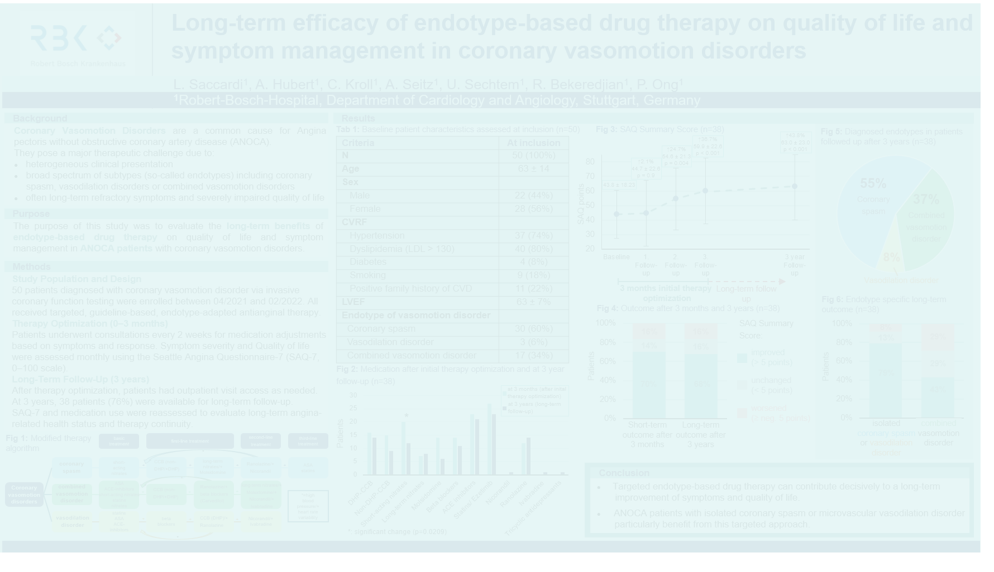
Background
Coronary Vasomotion Disorders are a common cause for Angina pectoris without obstructive coronary artery disease (ANOCA).
They pose a major therapeutic challenge due to:
heterogeneous clinical presentation
broad spectrum of subtypes (so-called endotypes) including coronary spasm, vasodilation disorders or combined vasomotion disorders
often long-term refractory symptoms and severely impaired quality of life
Purpose
The purpose of this study was to evaluate the long-term benefits of endotype-based drug therapy on quality of life and symptom management in ANOCA patients with coronary vasomotion disorders.

Slide 3
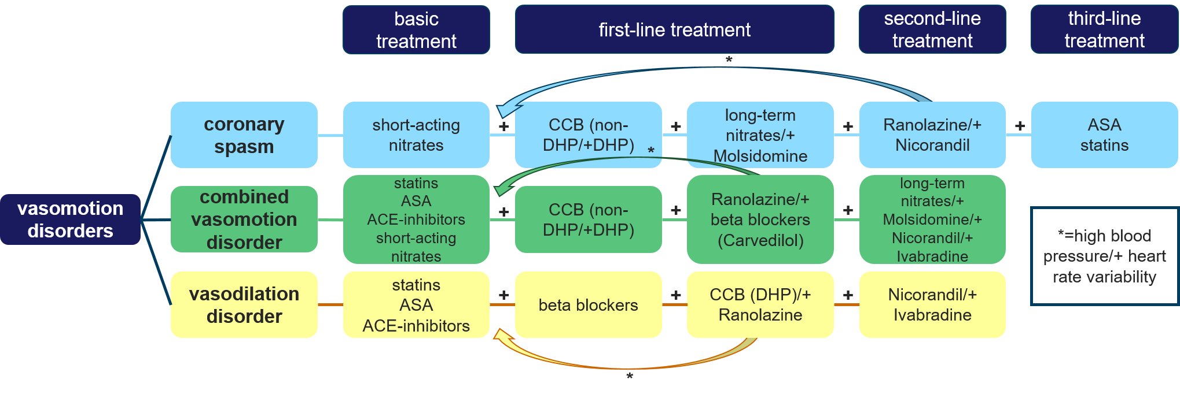
Methods
Study Population and Design 50 patients diagnosed with coronary vasomotion disorder via invasive coronary function testing were enrolled between 04/2021 and 02/2022. All received targeted, guideline-based, endotype-adapted antianginal therapy.
Therapy Optimization (0–3 months) Patients underwent consultations every 2 weeks for medication adjustments based on symptoms and response. Symptom severity and quality of life were assessed monthly using the Seattle Angina Questionnaire-7 (SAQ-7, 0–100 scale).
Long-Term Follow-Up (3 years) After therapy optimization, patients had outpatient visit access as needed. At 3 years, 38 patients (76%) were available for long-term follow-up.
SAQ-7 and medication use were reassessed to evaluate long-term angina-related health status and therapy continuity.

Slide 4
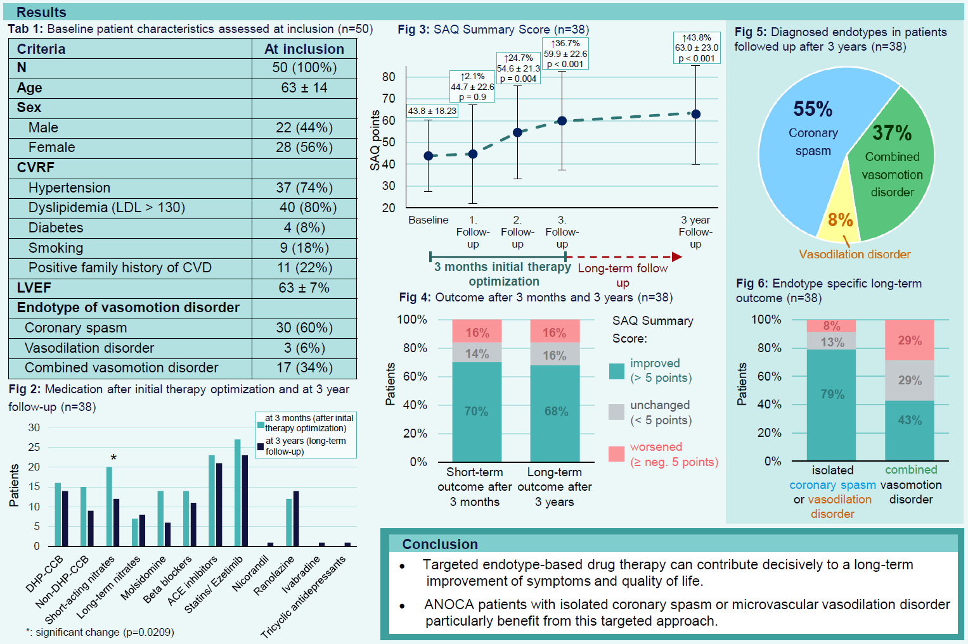

Slide 5

Thank you!
Leonie Saccardi
Researcher, Coronary Physiology Group
(led by Prof. Peter Ong, MD)
Bosch Health Campus GmbH
Department of Cardiology and Angiology, Robert Bosch Krankenhaus GmbH
Auerbachstraße 110 | 70376 Stuttgart | Germany Phone +49 711 8101-5588
Leonie.saccardi@rbk.de www.bosch-health-campus.com
© Bosch Health Campus GmbH 2024. Alle Rechte vorbehalten.
Bildnachweise: Fotostudio M42 (F. 5, 13, 14 unten) | Fotostudio M42 (F. 8, 14 oben) | Janina Rodeit, Swen Nowotnak (F. 11, 12)

